Slide 1
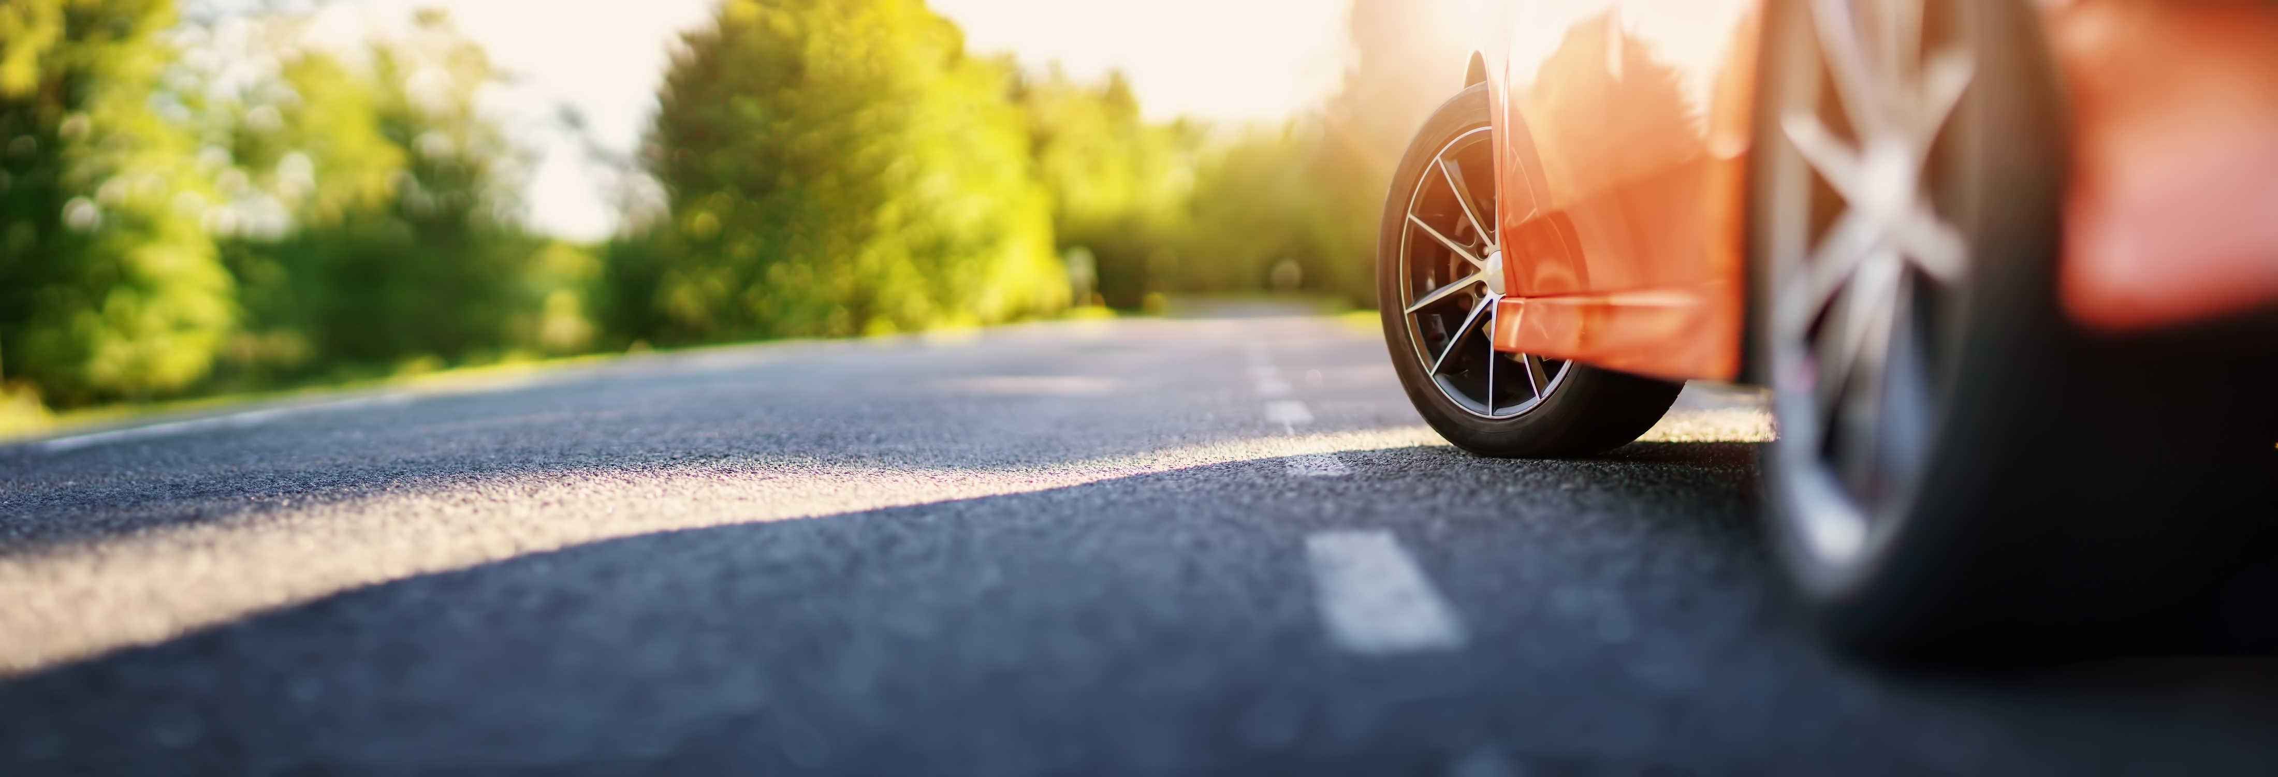
Forces and Vehicle Safety Task 11
Presented by Emma

Slide 2

Principle A - Increasing the time of the collision
Cars are designed to collapse on impact thus extending the time of the collision and reducing the impact force. This is the reason they can't be too durable
This reduces the impulse which is calculated as I = f x t
Crumple zones are areas of a vehicle that are designed to crush in a controlled way in a collision. They increase the time taken to change the momentum of the driver and passengers in a crash, which reduces the force involved.

Slide 3
Principle B- Spreading the forces of impact over the largest possible area & ensuring stability of the vehicle
ENSURING CAR STABILITY --- Lower centre of gravity, where the cars are lower to the ground and heavier at the base to stop the car from rolling over and causing harm to the people inside.
SPREADING THE FORCES --- Crumple zones at the front of the car spread the force of the crash so that less energy is transferred to the driver or passengers.

Slide 4
Principle C -Minimizing contact of the person with the interior of the vehicle
SEATBELTS & AIRBAGS --- Seatbelts help protect people from moving inside the car after a car accident so they don’t make contact with the inside of the car and hurt themselves. Airbags activate when the car has a crash and prevent the passenger or driver from hitting against the inside of the car.

Slide 5
Principle D - Keeping the person inside the vehicle
Safety features that keep the occupant in the car are seatbelts. If a crash was to occur, the occupant will continue to move forward. This applies to Newtons first law of motion.
That an object will continue to move unless acted upon by an external force.
If the car was to crash, the seatbelt will keep the driver and passengers locked it to avoid motion forward.

Slide 6

VW - 1960
A – This model lacked extra rear crumple space, this meant at the time of the collision the energy would be transferred directly to the driver.
B – This model sat quite high off the ground, this affects the stability of the car, as a lower centre of mass will increase the stability of the vehicle
C – This model of car did not have airbags, if the car was to crash, the person would not be kept safe inside.
D – This model did not have seat belts, if a crash was to occur, the occupant will continue to move in the direction of the windscreen. This will occur due to Newtons first law of motion (inertia)

Slide 7
Role of safety in a modern car
Features such as crumple zones, seat belts and airbags all provide protection if you have a crash, in addition there active safety assist technologies which also prevent a crash from occurring
The combination of a sound structure, good restraint systems and active safety assist technologies provide the best chance of survival in a crash

Slide 8
Improvements to better safety
Buy better tires
Tidy up gadgets & cables
Install a reversing camera
Install a blind spot warning system
Remove the bull bar

